Slide 1


Real-Time Event Management System
Project-Based Learning – Review 4 | Results & Analysis
TEAM MEMBERS
INSTITUTION
M. Balaji
Ruthvik
Krithik Reddy
Karthikeya
Faculty Mentor: Dr. [Name]
Department: B.Tech CSE – AI & Data Science
Institution: KL University, Hyderabad
Academic Year: 2026–2027

Slide 2
Project Objectives
Event Lifecycle Management
QR-Based Attendance
Centralized platform for event creation, information management, and end-to-end lifecycle coordination.
Digital QR check-in for accurate, real-time attendance verification — eliminating manual errors.
Analytics & Reporting
Scalable & Adaptable
Real-time dashboards, notifications, and performance insights for organizers and participants.
Designed for academic, professional, and competitive events with capacity tracking and centralized data.

Slide 3

Project Development Approach
Development Lifecycle
Requirements
System Functional Workflow
System Design
Modular development enabled independent component implementation and progressive integration, ensuring systematic validation at each stage.
Database Design
Module Development
01
02
03
Event Creation
Participant Registration
QR Code Generation & Check-In
04
05
Attendance Recording & DB Storage
Real-Time Dashboard & Analytics

Slide 4
Project Implementation
Technology Stack
Implementation Modules
Module | Status
Event Management | ✓ Completed
Registration & Capacity | ✓ Completed
QR Attendance | ✓ Completed
Notifications | [STATUS]
Analytics Dashboard | [STATUS]
Database Management | ✓ Integrated
Frontend
Backend
[React.js + Vite + Tailwind CSS]
Node.js + Express.js
Database
APIs
PostgreSQL
[
[REST API+JSON
QR / Attendance
Version Control
[QR Code Generation + QR Scanner
Git + GitHub
[]

Slide 5
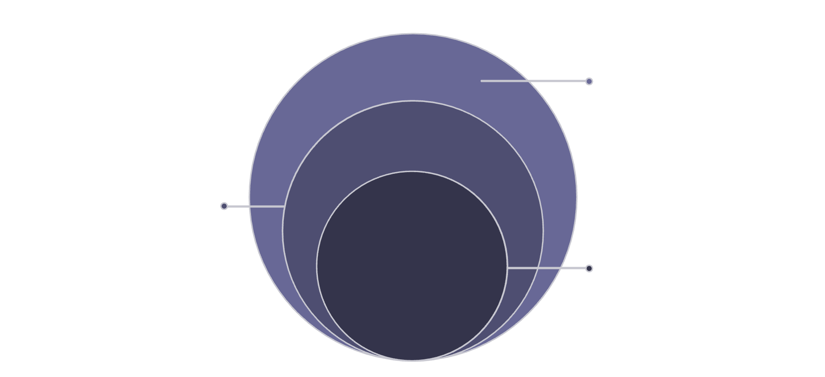

System Architecture
Data Flow
User requests originate at the Frontend UI and pass through the API Layer to backend services. Each service independently handles event logic, attendance recording, or notifications before persisting data to the centralized database.
The real-time processing layer continuously syncs the dashboard and analytics view, ensuring organizers always see live participant and attendance data.
Frontend & Real-Time
Users, web UI, API, processing, analytics
Backend Services
Event, attendance, notification logic
Core Database
Centralized persistent store
Modular backend services enable independent scaling and fault isolation across all functional components.

Slide 6
Screens & Working Demonstration
The following screens illustrate the complete user journey through the system — from authentication through event creation, registration, QR check-in, and live dashboard reporting.
# | Screen
1 | Login Page
2 | Home Page
3 | Main Application
4 | Event Creation Form
5 | Registration Page
6 | QR Attendance Check-In
7 | Dashboard
8 | Output / Results Page

Slide 7
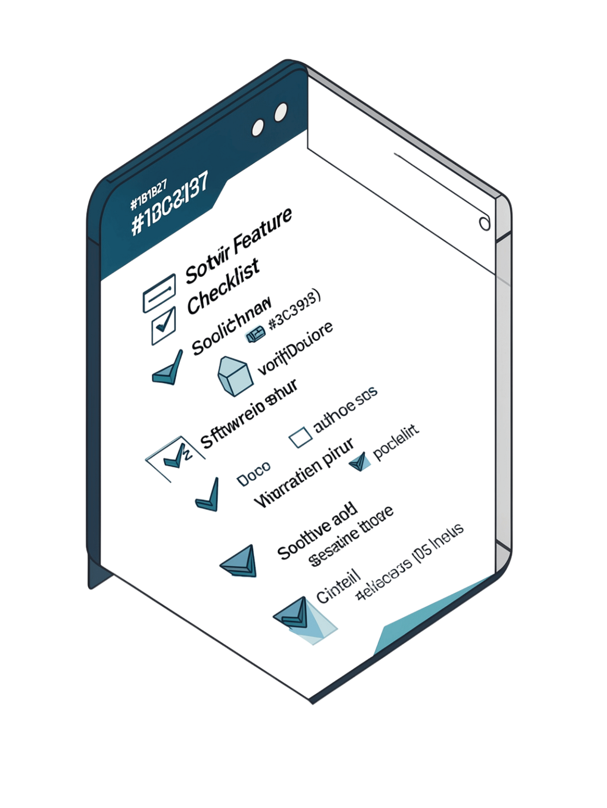
Functional Results
✓ Event Creation
Users can create and manage full event information successfully.
✓ Capacity Management
Event capacity and participant limits enforced at registration.
✓ Participant Registration
Participants can register; data maintained centrally with tracking.
✓ QR Attendance
QR-based check-in records and displays live attendance status.
Notifications
Analytics Dashboard
Database Operations
Real-Time Updates
✓ Automated Event Alerts
Registration confirmations, event updates, reminders, and check-in notifications are provided to users.
✓ Event Insights
Displays registrations, attendance, capacity, and event performance for organizers.
✓ Centralized Data Management
Event, participant, registration, and attendance data are managed through the backend and PostgreSQL database.
✓ Live System Updates
Dashboard information can be updated in real time using Socket.IO.

Slide 8
Testing Results
Functional test cases were executed across all implemented modules. Fill in the status column with actual pass/fail outcomes from your test run.
Test Case | Expected Result
Event Creation | Event created successfully
Participant Registration | Participant registered
Capacity Validation | Capacity enforced
QR Verification | Valid QR records attendance
Duplicate Registration | Duplicate prevented
Database Operation | Data stored/retrieved correctly
API Request | Correct response returned
Dashboard Update | Updated data reflected
Notification | Notification triggered
Analytics | Correct metrics displayed

Slide 9

Results & Analysis
System Achievement Summary
Before vs. After Impact
Core modules — Event Management, Registration & Capacity, and QR Attendance — are successfully implemented and integrated. The system enables complete end-to-end event lifecycle management from creation through live attendance tracking.
The Frontend → Backend/API → Database → Dashboard workflow is fully operational, with real-time data synchronization enabling live event monitoring and participant tracking.
Aspect | Before | After
Event Management | Disconnected processes | Centralized platform
Attendance Recording | Manual, error-prone | Digital QR-based
Data Tracking | Difficult, scattered | Centralized tracking
Event Visibility | Limited visibility | Real-time dashboard
Accuracy
Efficiency
Scalability

